Slide 1
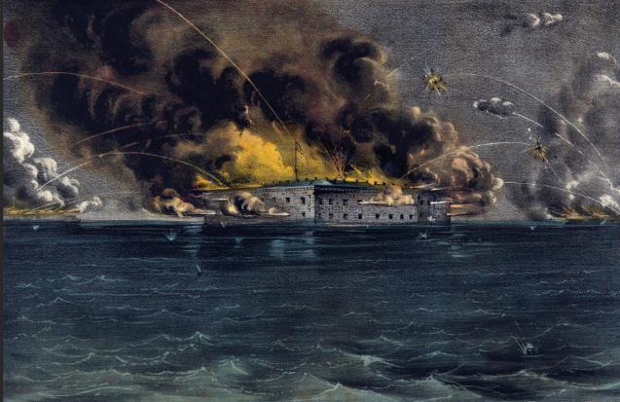
Think you know who started the Civil War?
THINK AGAIN

Slide 2


Learn the true history of the south. Join the Sons of Confederate Veterans, Texas Division, today!
The U. S. Navy landed troops to reinforce Fort Pickens on April 11, 1861 in direct violation of an armistice agreement between the Federal Government and the Southern States. In his report to the Secretary of the Navy, U.S. Captain Adams wrote: “It would be considered not only a declaration but an act of war; and would be resisted to the utmost.” Fort Sumpter was fired upon on April 12, after Lincoln attempted to reinforce it with troops and supplies. The U.S. government committed to the war one month before when the order to reinforce was given on March 12, despite on-going peace negotiations.

