Slide 1
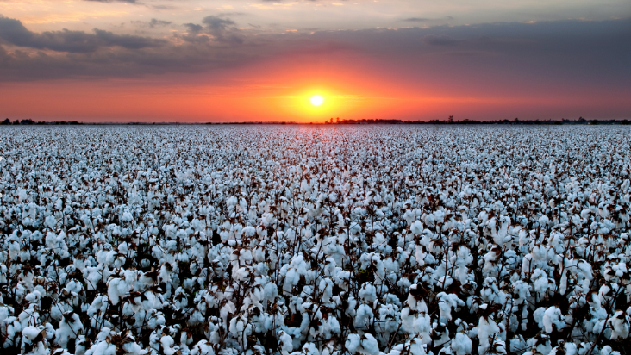
Think Lincoln freed the slaves with his Emancipation Proclamation?
THINK AGAIN
Think you know who started the Civil War?
THINK AGAIN

Slide 2


Learn the true history of the south. Join the Sons of Confederate Veterans, Texas Division, today!
The Emancipation Proclamation declared slaves in the Confederate States of America to be free (a separate and sovereign nation).
It did not apply to:
Union slave states (Kentucky, Missouri, Maryland, Delaware)
Confederate areas already under Union control
The 13th Amendment to the Constitution, December 6, 1865, almost nine months after Lincoln’s death, freed all the slaves in the newly reformed
United States of America.

